Slide 1
Efficient and Effective Local Algorithms
for Analyzing Massive Graphs
Yubao Wu
Case Western Reserve University
August 28, 2015
Notes:
Good morning, everyone. The title of my dissertation is “efficient and effective local algorithms for analyzing massive graphs”.

Slide 2
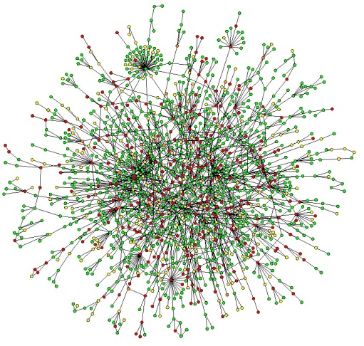
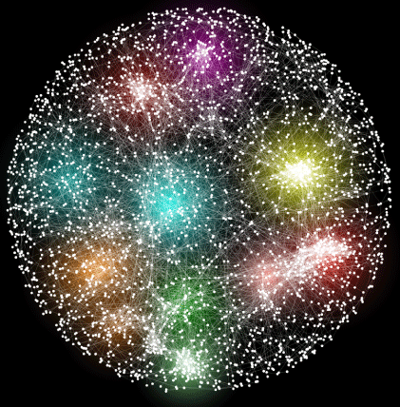








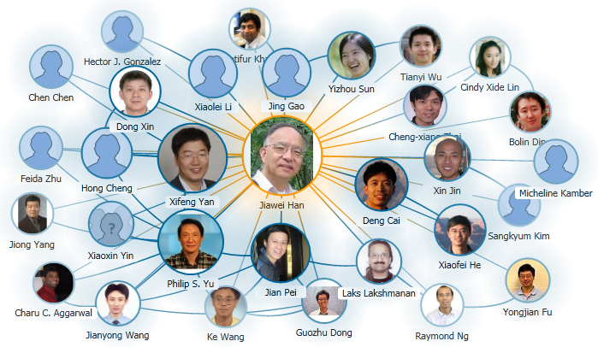
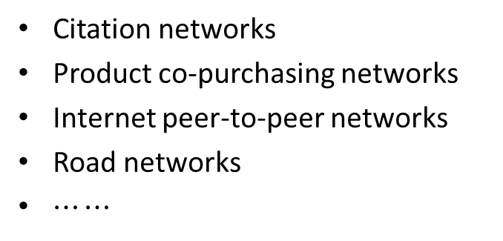
Graphs are Everywhere
Social Networking Websites
Biological Networks
Citation networks
Product co-purchasing networks
Internet peer-to-peer networks
Road networks
$⋯⋯$
Research Collaboration Network
Notes:
Graphs are everywhere. There are many social networks and biological networks. We also have research collaboration network, citation network, product co-purchasing network, internet network, road network, and so on. Where there is information, there are networks!

Slide 3
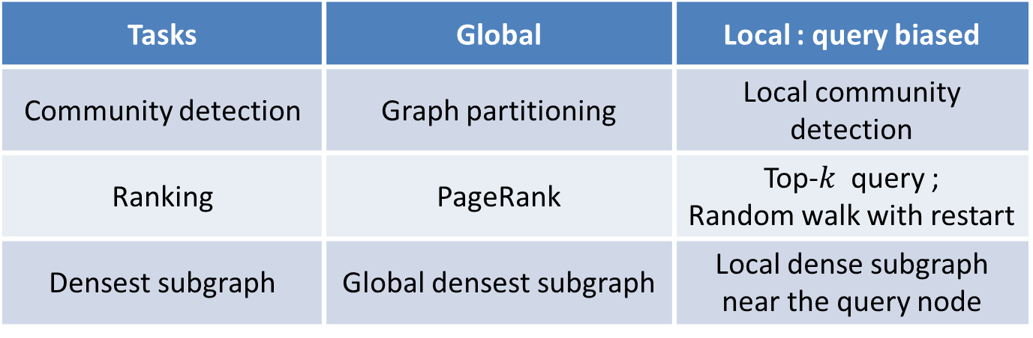
Primitive Tasks
Tasks | Global | Local : query biased
Community detection | Graph partitioning | Local community detection
Ranking | PageRank | Top-$k$ query ; Random walk with restart
Densest subgraph | Global densest subgraph | Local dense subgraph near the query node
Applications:
Recommendation
Disease gene discovery
Advertisement
Disease pathway discovery
Notes:
There are several primitive tasks in analyzing the graphs, such as community detection, ranking, and densest subgraph detection. These tasks have numerous applications, such as recommendation, advertisement, disease gene discovery.
The graphs are becoming larger and larger. The current graphs contain billions of nodes. Thus it is prohibitive for the existing global algorithms to process large graphs. Therefore, people become interested in the local versions of these problems. Given a query node, the local community detection problem aims at finding the community near the query node. Given a query node, the top-k query problem aims at finding the top-k nodes which are most similar to the query node. Given a query node, we are also interested in finding the local dense subgraph near the query node.

Slide 4
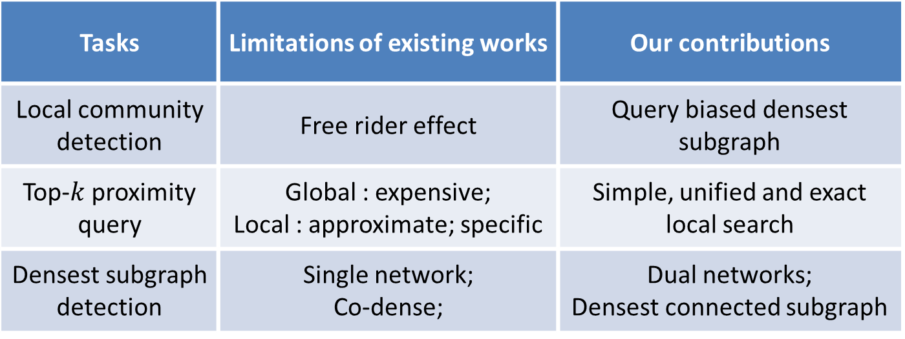

Contributions
Tasks | Limitations of existing works | Our contributions
Local community detection | Free rider effect | Query biased densest subgraph
Top-$k$ proximity query | Global : expensive; Local : approximate; specific | Simple, unified and exact local search
Densest subgraph detection | Single network; Co-dense; | Dual networks; Densest connected subgraph
Yubao Wu, Ruoming Jin, Jing Li, and Xiang Zhang. Robust local community detection: on free rider effect and its elimination. PVLDB, 2015.
Yubao Wu, Ruoming Jin, Xiang Zhang. Fast and unified local search for random walk based $k$-nearest-neighbor query in large graphs. SIGMOD, 2014.
Yubao Wu, Ruoming Jin, Xiaofeng Zhu, and Xiang Zhang. Finding dense and connected subgraphs in dual networks. ICDE, 2015.
Notes:
My research work focuses on finding these local patterns in graphs. This table lists the limitations of the existing works and our contributions.
For the local community detection problem, we discover that the existing methods suffer from the free rider effect. And we propose the query biased densest subgraph to eliminate the free rider effect.
For the top-k query problem, the existing methods either are expensive or approximate. We develop a simple, unified and exact local search algorithm.
The densest subgraph problem is defined in a single network. We observe the dual networks in real applications. We extend the densest subgraph problem into this dual networks model, and study the densest connected subgraph problem.
Let’s first take a look at the local community detection problem.

Slide 5
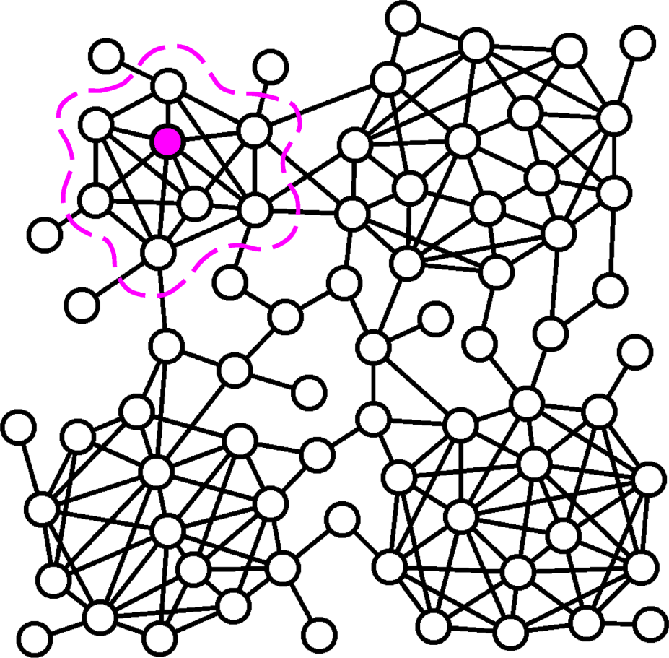
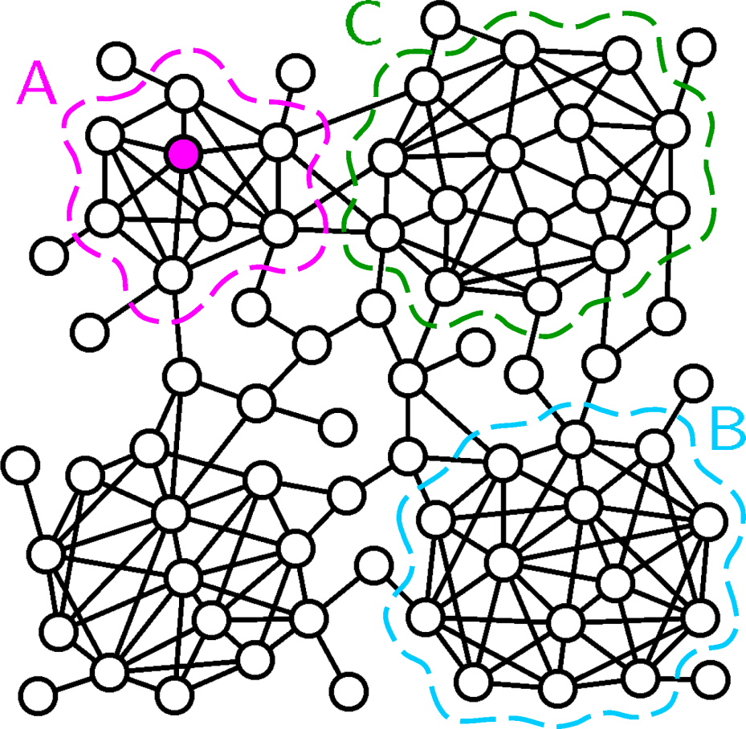
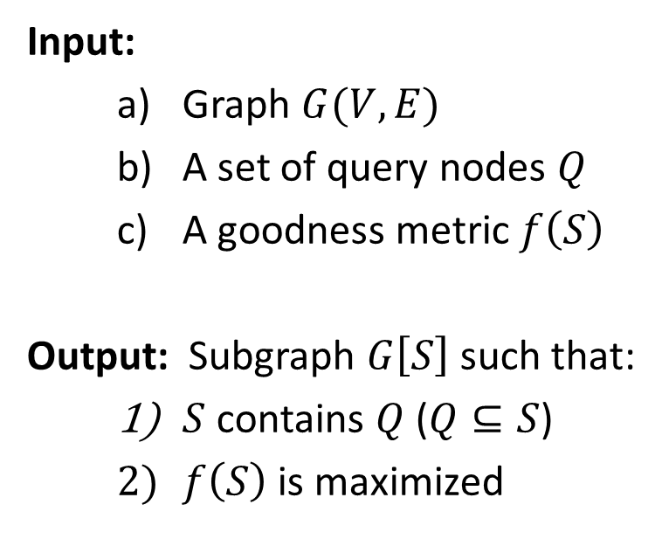
Generic Local Community Detection Problem
Input:
Graph $G(V,E)$
A set of query nodes $Q$
A goodness metric $f\left(S\right)$
Output: Subgraph $G\left[S\right]$ such that:
$S$ contains $Q$ ($Q⊆S$)
$f\left(S\right)$ is maximized
A
[1] M. Sozio, et al. KDD’10.
[2] W. Cui, et al. SIGMOD’14.
[3] L. Ma, et al. DaWak’13.
[4] B. Saha, et al. RECOMB’10.
[5] C. Tsourakakis, et al. SIGMOD’14.
[6] A. Clauset, PRE’05.
[7] F. Luo, et al. WIAS’08.
[8] R. Andersen, et al. FOCS’06.
Notes:
The community is usually defined as a subgraph that is densely connected inside and sparsely connected outside. A goodness metric is usually used to measure the goodness of a community.
Given a graph and a query node, the local community detection problem aims at finding a community near the query node. In this example, the purple node is the query node, and subgraph A in the purple curve is the local community to be detected.
But all the existing methods tend to include irrelevant subgraphs, such as subgraph B or C, in the detected community. In this work, we try to remedy the existing works.
The local community detection problem can be defined in this generic form. The inputs include a graph, a set of query nodes, and a goodness metric. The output is a subgraph such that the subgraph contains the query nodes, and the goodness metric is maximized.

Slide 6
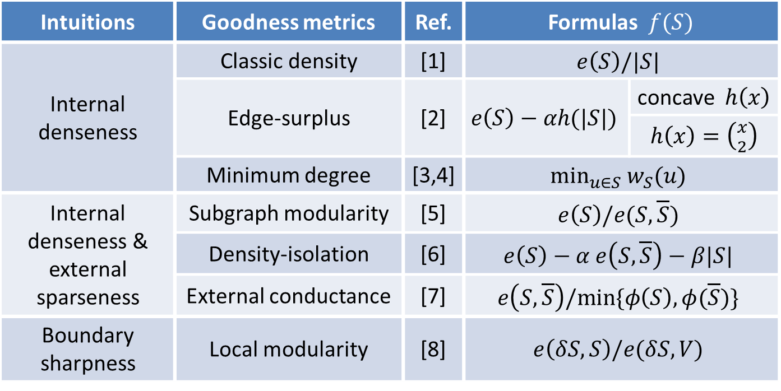
Community Goodness Metrics
Intuitions | Goodness metrics | Ref. | Formulas $f(S)$
Internal denseness | Classic density | [1] | $$e\left(S\right)/|S|$$
 | Edge-surplus | [2] | $$e\left(S\right)−αh(|S|)$$ | concave $h\left(x\right)$
 |  |  |  | $h\left(x\right)=\left({x \atop 2}\right)$
 | Minimum degree | [3,4] | $$\min_{u∈S} w_{S}(u)$$
Internal denseness & external sparseness | Subgraph modularity | [5] | $$e\left(S\right)/e(S,\overline{S})$$
 | Density-isolation | [6] | $$e\left(S\right)−α e\left(S,\overline{S}\right)−β|S|$$
 | External conductance | [7] | $$e\left(S,\overline{S}\right)/min⁡\{φ\left(S\right),φ(\overline{S})\}$$
Boundary sharpness | Local modularity | [8] | $$e\left(δS,S\right)/e(δS,V)$$
[1] B. Saha, et al. RECOMB’10.
[2] C. Tsourakakis, et al. SIGMOD’14.
[3] M. Sozio, et al. KDD’10.
[4] W. Cui, et al. SIGMOD’14.
[5] F. Luo, et al. WIAS’08.
[6] K. J. Lang, CIKM’07.
[7] R. Andersen, et al. FOCS’06.
[8] A. Clauset, PRE’05.
Notes:
Many goodness metrics have been proposed. This table shows some existing goodness metrics. They can be categorized into three classes. The first class optimizes the internal denseness. It includes classic density, edge-surplus, and minimum degree. The second class optimizes both internal denseness and external sparseness. It includes subgraph modularity, density-isolation, and external conductance. The third class optimizes the boundary sharpness. It includes local modularity.

Slide 7
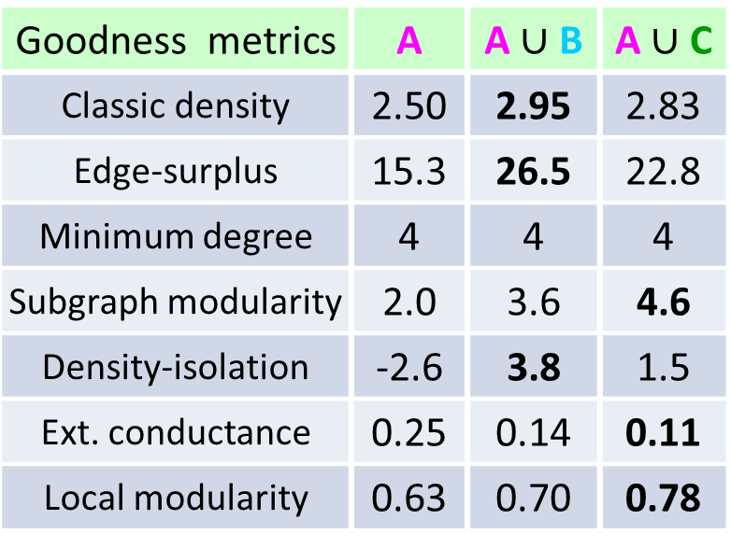
Free Rider Effect
Goodness metrics | A | A $\text{∪}$ B | A $\text{∪}$ C
Classic density | 2.50 | 2.95 | 2.83
Edge-surplus | 15.3 | 26.5 | 22.8
Minimum degree | 4 | 4 | 4
Subgraph modularity | 2.0 | 3.6 | 4.6
Density-isolation | -2.6 | 3.8 | 1.5
Ext. conductance | 0.25 | 0.14 | 0.11
Local modularity | 0.63 | 0.70 | 0.78
[1] B. Saha, et al. RECOMB’10.
[2] C. Tsourakakis, et al. SIGMOD’14.
[3] M. Sozio, et al. KDD’10.
[4] W. Cui, et al. SIGMOD’14.
[5] F. Luo, et al. WIAS’08.
[6] K. J. Lang, CIKM’07.
[7] R. Andersen, et al. FOCS’06.
[8] A. Clauset, PRE’05.
Notes:
But the existing methods tend to include irrelevant subgraphs in the detected local community.
This toy graph contains four communities. Suppose that the purple node is the query node and subgraph A is the local community to be detected. Suppose that we use the classic density as the goodness metric. Classic density measures the average degree of the nodes in the subgraph. In this example, the density of subgraph A is 2.5, but the density of the union of subgraphs A and B is 2.95, which is greater than the density of subgraph A.
Because we want to maximize the goodness value, the union of subgraphs A and B is a better solution than subgraph A. This is counter-intuitive.
We study other goodness metrics. This table shows the results. We can see that all of them suffer from the same problem.
We call subgraph B or C the free rider subgraph. And we call this phenomenon the free rider effect. We theoretically prove that all the existing goodness metrics suffer from the free rider effect. This motivates us to study how to eliminate the free rider effect.

Slide 8

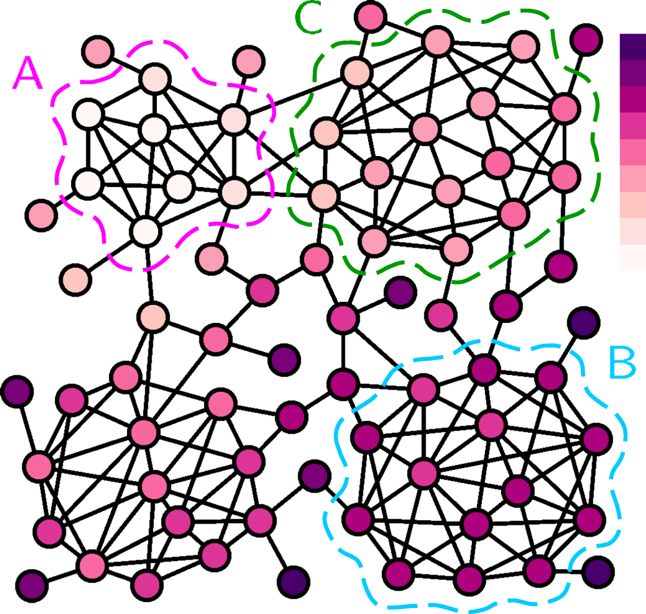
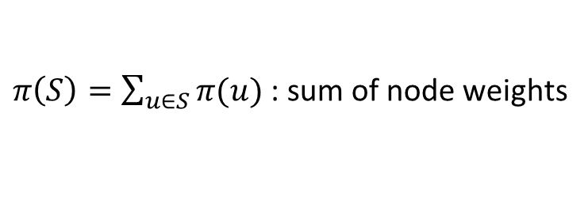
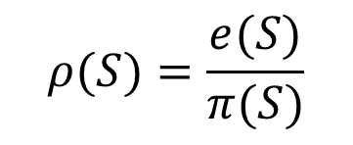
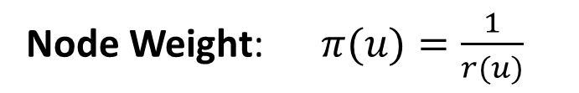
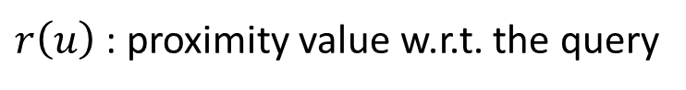
Query Biased Node Weighting
Node Weight: $π(u)=\frac{1}{r(u)}$
$r\left(u\right)$ : proximity value w.r.t. the query
Query biased density:
$$ρ(S)=\frac{e(S)}{π(S)}$$
$π\left(S\right)=\sum_{u∈S}{π(u)}$ : sum of node weights
Subgraph A becomes the
query biased densest subgraph
Yubao Wu, Ruoming Jin, Jing Li, and Xiang Zhang. Robust local community detection: on free rider effect and its elimination. PVLDB, 8(7):798-809, 2015.
Notes:
We propose a query biased node weighting scheme. Given a graph and a query node, we first compute the proximity value of each node with regard to the query node. Then, the node weight is defined as the inverse of the proximity value. This figure visualizes the distribution of the node weights. The darker the node color, the larger the node weight. We can see that if one node is far away from the query node, it has large node weight.
After we get the node weights, we define a new goodness metric: the query biased density. It equals the summation of edge weights divided by the summation of node weights. The denominator is the sum of node weights. Thus, if one subgraph contains some nodes that are far away from the query node, the query biased density will be small. Because those nodes have large node weights.
In this example, subgraph A is the query biased densest subgraph. Previously, subgraph B is the densest subgraph.

Slide 9
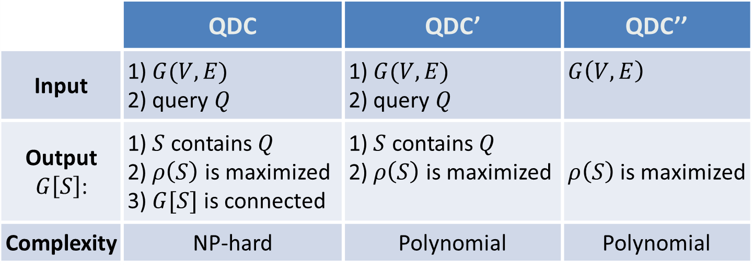
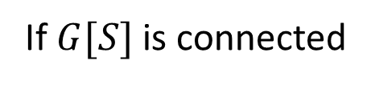
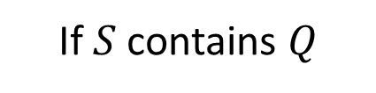
Query Biased Densest Connected Subgraph (QDC) Problem and Two Related Problems
 | QDC | QDC’ | QDC’’
Input | 1) $G(V,E)$ 2) query $Q$ | 1) $G(V,E)$ 2) query $Q$ | $G\left(V,E\right)$
Output $G\left[S\right]$: | 1) $S$ contains $Q$ 2) $ρ\left(S\right)$ is maximized 3) $G[S]$ is connected | 1) $S$ contains $Q$ 2) $ρ\left(S\right)$ is maximized | $ρ\left(S\right)$ is maximized
Complexity | NP-hard | Polynomial | Polynomial
Optimal
Optimal
If $G[S]$ is connected
If $S$ contains $Q$
Yubao Wu, Ruoming Jin, Jing Li, and Xiang Zhang. Robust local community detection: on free rider effect and its elimination. PVLDB, 8(7):798-809, 2015.
Notes:
Based on the query biased density, we define a new problem, the query biased densest connected subgraph problem. We also call it the QDC problem. The inputs include a graph and a set of query node. The output is a subgraph such that the subgraph contains the query nodes, the query biased density is maximized, and the subgraph is connected.
The QDC problem is NP-hard. Therefore, we study two related problems that have fewer constraints than the QDC problem.
The first related problem aims at finding the query biased densest subgraph that contains the query nodes. The resulting subgraph maybe disconnected. The second related problem aims at finding the query biased densest subgraph without any constraint. These two related problems can be solved in polynomial time.
If the solutions of these two related problems satisfy some additional constraints, they will become the optimal solution of the original QDC problem.
Intuitively, the query biased densest subgraph should be in the neighborhood of the query node. Therefore, it is likely that the query biased densest subgraph contains the query node and is connected. The experimental results demonstrate that with a probability of 95%, we can find the exact solution of the QDC problem based on the solutions of these two related problem.

Slide 10
Experiments——Datasets
Dataset | # Nodes | # Edges | # Communities
Amazon | 00,334,863 | 0,000,925,872 | 0,151,037
DBLP | 00,317,080 | 0,001,049,866 | 0,013,477
Youtube | 01,134,890 | 0,002,987,624 | 0,008,385
Orkut | 03,072,441 | 0,117,185,083 | 6,288,363
LiveJournal | 03,997,962 | 0,034,681,189 | 0,287,512
Friendster | 65,608,366 | 1,806,067,135 | 0,957,154
[1] J. Yang and J. Leskovec. Defining and evaluating network communities based on ground-truth. In ICDM, 2012.
[2] snap.stanford.edu
Notes:
In the experiments, we use a set of real large graphs. This table shows the basic statistics of the graphs. The graphs contain up to tens of millions of nodes and billions of edges. The graphs also contain the ground truth communities.

Slide 11
Experiments——State-of-the-Art Methods
Classes | Abbr. | Ref. | Key Idea
Internal denseness | DS | [1] | Densest subgraph with query constraint
 | OQC | [2] | Optimal quasi-clique; edge-surplus
 | MDG | [3] | Minimum degree
Internal denseness & external sparseness | PRN | [4] | External conductance
 | LS | [5] | Local spectral
 | EMC | [6] | More internal edges than external edges
 | SM | [7] | Subgraph modularity
Boundary | LM | [8] | Local modularity
[1] B. Saha, et al. RECOMB’10.
[2] C. Tsourakakis, et al. SIGMOD’14.
[3] M. Sozio, et al. KDD’10.
[4] R. Andersen, et al. FOCS’06.
[5] M. W. Mahoney, et al. JMLR’12.
[6] G. W. Flake, KDD’00.
[7] F. Luo, et al. WIAS’08.
[8] A. Clauset, PRE’05.
Notes:
We compare our method with several state-of-the-art methods. These methods can be categorized into three classes based on the goodness metrics they are optimizing. The first class optimizes the internal denseness. The second class optimizes both the internal denseness and external sparseness. The third class optimizes the boundary sharpness.

Slide 12

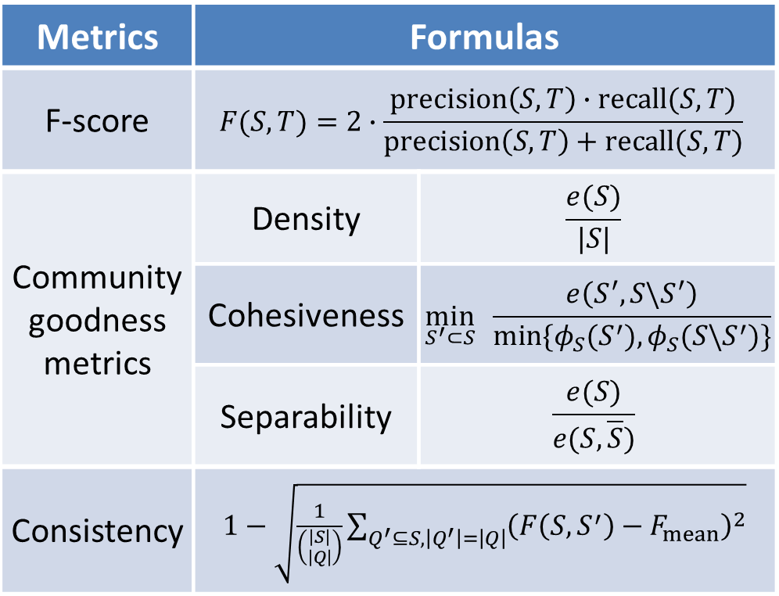
Experiments: Effectiveness Evaluation Metrics
Metrics | Formulas
F-score | $$F(S,T)=2∙\frac{precision\left(S,T\right)∙recall(S,T)}{precision\left(S,T\right)+recall(S,T)}$$
Community goodness metrics | Density | $$\frac{e(S)}{|S|}$$
 | Cohesiveness | $$\min_{S^{′}⊂S}{ \frac{e\left(S^{′},S\backslash S^{′}\right)}{min⁡\{φ_{S}(S^{′}),φ_{S}({S\backslash S}^{′})\}}}$$
 | Separability | $$\frac{e(S)}{e(S,\overline{S})}$$
Consistency | $1−\sqrt{\frac{1}{\left({\left|S\right| \atop \left|Q\right|}\right)}\sum_{Q^{′}⊆S,\left|Q^{′}\right|=\left|Q\right|}{{\left(F\left(S,S^{′}\right)−F_{mean}\right)}^{2}}}$
[1] J. Yang and J. Leskovec. Dening and evaluating network communities based on ground-truth. In ICDM, pages 745-754, 2012.
[2] Ma, Lianhang, et al. GMAC: A seed-insensitive approach to local community detection. In DaWak, pages 297-308, 2013.
Notes:
We use three metrics to evaluate the effectiveness.
The first one is F-score. It measures the accuracy given the ground truth community.
The second one is a set of community goodness metrics, which includes density, cohesiveness, and separability.
The third one is consistency. Intuitively, if we pick any node from one community as the query node, the method should always return the same community. Given the detected community, we randomly pick one node as the query node, detect the local community and compute the F-score. We repeat this process and can get a set of F-scores. If the algorithm is consistent, the variance of the F-scores should be small. Therefore, we use the variance of F-scores to define the consistency.

Slide 13
Effectiveness Evaluation —— F-Score
F-score | QDC | DS | OQC | MDG | PRN | LS | EMC | SM | LM
Amazon | 0.83 | 0.52 | 0.54 | 0.46 | 0.69 | 0.66 | 0.61 | 0.60 | 0.58
DBLP | 0.46 | 0.31 | 0.33 | 0.32 | 0.48 | 0.42 | 0.34 | 0.36 | 0.37
Youtube | 0.43 | 0.23 | 0.22 | 0.17 | 0.26 | 0.24 | 0.21 | 0.21 | 0.22
Orkut | 0.47 | 0.15 | 0.16 | 0.13 | 0.21 | 0.17 | 0.19 | 0.16 | 0.18
LiveJournal | 0.64 | 0.48 | 0.47 | 0.40 | 0.52 | 0.51 | 0.47 | 0.48 | 0.49
Friendster | 0.32 | -- | 0.14 | 0.12 | 0.17 | 0.16 | -- | 0.14 | 0.13
Avg. F-score | 0.53 | 0.3 | 0.31 | 0.27 | 0.39 | 0.36 | 0.33 | 0.33 | 0.33
Avg. Precision | 0.65 | 0.46 | 0.45 | 0.29 | 0.51 | 0.41 | 0.34 | 0.38 | 0.48
Avg. Recall | 0.78 | 0.61 | 0.58 | 0.69 | 0.67 | 0.64 | 0.66 | 0.63 | 0.59
Yubao Wu, Ruoming Jin, Jing Li, and Xiang Zhang. Robust local community detection: on free rider effect and its elimination. PVLDB, 8(7):798-809, 2015.
Notes:
This table shows the F-score results. Each row corresponds to a dataset; each column corresponds to a method. We can see that our method has the best performance on most datasets.

Slide 14
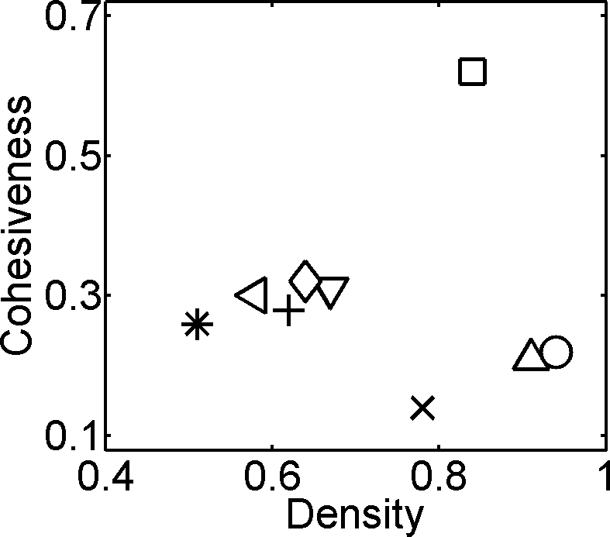
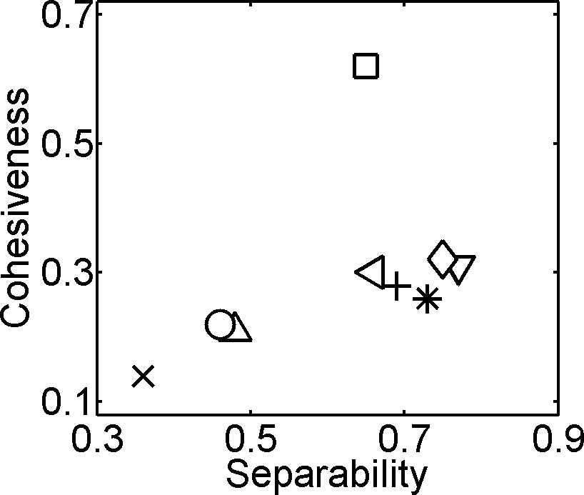
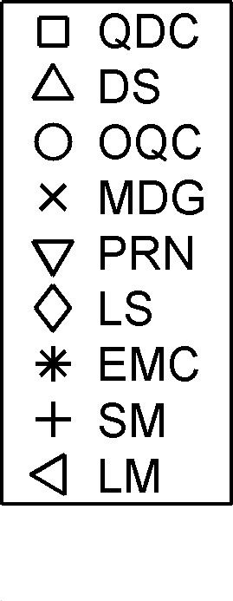
Effectiveness Evaluation——Goodness Metrics
Community goodness metrics on LiveJournal graph
Yubao Wu, Ruoming Jin, Jing Li, and Xiang Zhang. Robust local community detection: on free rider effect and its elimination. PVLDB, 8(7):798-809, 2015.
Notes:
These figures show the distribution of community goodness metrics. They are cohesiveness, density and separability. The larger the goodness value, the better the performance. The square marker denotes our QDC method. We can see that our method has high cohesiveness, high density, and high separability. The remaining methods have low cohesiveness value because they suffer from the free rider effect.

Slide 15
Effectiveness Evaluation——Consistency
Consistency | QDC | DS | OQC | MDG | PRN | LS | EMC | SM | LM
Amazon | 0.94 | 0.77 | 0.76 | 0.58 | 0.79 | 0.69 | 0.74 | 0.67 | 0.61
DBLP | 0.88 | 0.62 | 0.64 | 0.37 | 0.65 | 0.53 | 0.56 | 0.43 | 0.56
Youtube | 0.85 | 0.61 | 0.54 | 0.46 | 0.71 | 0.41 | 0.57 | 0.37 | 0.36
Orkut | 0.83 | 0.56 | 0.52 | 0.32 | 0.68 | 0.43 | 0.51 | 0.54 | 0.47
LiveJournal | 0.93 | 0.74 | 0.67 | 0.43 | 0.84 | 0.64 | 0.73 | 0.58 | 0.52
Friendster | 0.78 | -- | 0.56 | 0.45 | 0.65 | 0.49 | -- | 0.32 | 0.39
Average | 0.87 | 0.64 | 0.62 | 0.44 | 0.72 | 0.53 | 0.61 | 0.49 | 0.49
Yubao Wu, Ruoming Jin, Jing Li, and Xiang Zhang. Robust local community detection: on free rider effect and its elimination. PVLDB, 8(7):798-809, 2015.
Notes:
This table shows the consistency results. Each row corresponds to a dataset; each column corresponds to a method. We can see that our method is the most consistent method.

Slide 16
Contributions
Tasks | Limitations of existing works | Our contributions
Local community detection | Free rider effect | Query biased densest subgraph
Top-$k$ proximity query | Global : expensive; Local : approximate; specific | Simple, unified and exact local search
Densest subgraph detection | Single network; Co-dense; | Dual networks; Densest connected subgraph
Yubao Wu, Ruoming Jin, Jing Li, and Xiang Zhang. Robust local community detection: on free rider effect and its elimination. PVLDB, 2015.
Yubao Wu, Ruoming Jin, Xiang Zhang. Fast and unified local search for random walk based $k$-nearest-neighbor query in large graphs. SIGMOD, 2014.
Yubao Wu, Ruoming Jin, Xiaofeng Zhu, and Xiang Zhang. Finding dense and connected subgraphs in dual networks. ICDE, 2015.
Notes:
In conclusion, the free rider effect is a serious problem in local community detection. The proposed query biased node weighting scheme can effectively eliminate the free rider effect. Next, let’s take a look at the top-k proximity query problem.

Slide 17
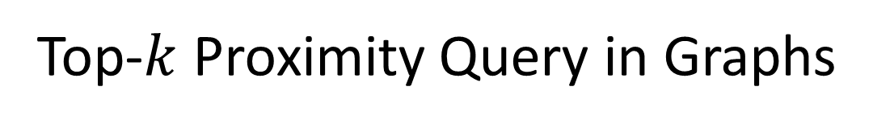

Top-$k$ Proximity Query in Graphs
Which nodes are most similar to the query node ?
Random walk based proximity measures
Random walk with restart
Hitting time
Commute time
Query
Yubao Wu, Ruoming Jin, Xiang Zhang. Fast and unified local search for random walk based $k$-nearest-neighbor query in large graphs. SIGMOD, 2014.
Notes:
What is the top-k query in graphs? Given a graph and a query node, we wanna find which other nodes are most similar to the query node.
For example, given the red query node, the green node should be similar to the query node, because it is adjacent to the query node. But the purple node should also be similar to the query node, because it has multiple paths connecting to the query node.
Many random walk based proximity measures have been proposed to define the proximity values. Such as random walk with restart, hitting time, and commute time.

Slide 18
Computational Methods for Top-𝑘 Query
Methods | Key Idea | Pre-computation? | Applicability
Global iteration (GI) | Power method | No | Wide
Matrix based method[2] | Matrix decomposition | Yes | RWR
Graph embedding [3] | Graph embedding | Yes | RWR / HT / CT
Disadvantages:
Iterating over the entire graph
Pre-computing step is expensive
Challenge: An efficient local search method?
Guarantees the exactness
Applies to different measures
[1] Y. Fujiwara, et al. SIGMOD’13
[2] Tong’ICDM’06; Fujiwara’KDD’12; Fujiwara’VLDB’12
[3] X. Zhao, et al. VLDB’13
Notes:
Many computational methods have been proposed to compute the top-k nodes.
The most basic one is the global iteration method. The random walk process can be represented as a linear system. So power iteration method can be used to solve the linear system. But it needs to iterate over the entire graph. So the computational complexity is high.
The matrix based methods are specially designed for random walk with restart. They need to pre-compute the matrix inversion, thus the pre-computing step is expensive.
Graph embedding method embeds the graph into geometric space first. But the graph embedding step is approximate, and it is also time-consuming.

Slide 19
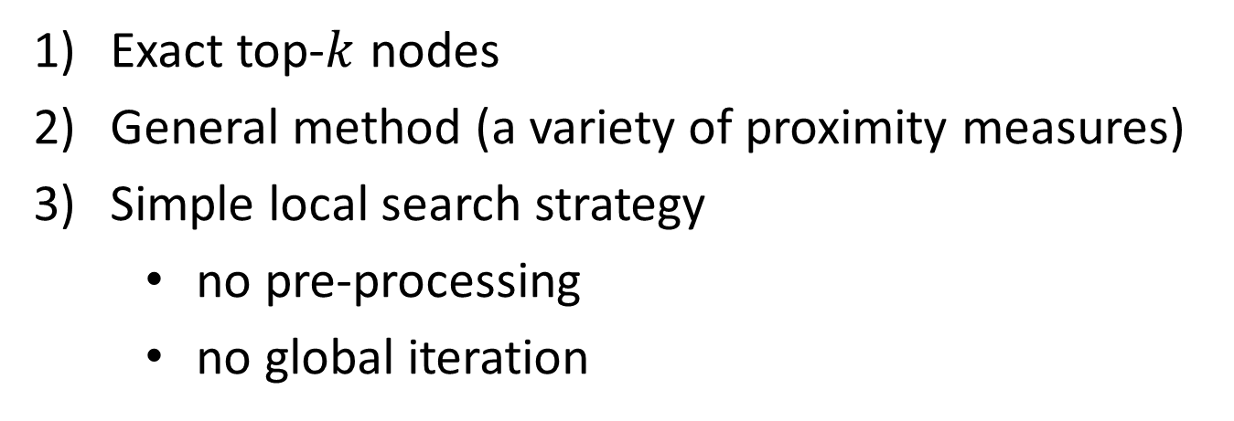
Our Method —— FLoS (Fast Local Search)
Contributions:
Exact top-$k$ nodes
General method (a variety of proximity measures)
Simple local search strategy
no pre-processing
no global iteration
Yubao Wu, Ruoming Jin, Xiang Zhang. Fast and unified local search for random walk based $k$-nearest-neighbor query in large graphs. SIGMOD, 2014.
Notes:
In this work, we propose the fast local search algorithm. It has three nice properties.
First, it guarantees the exactness of the top-k nodes;
Second, it is a general method that can be applied to a variety of proximity measures;
Third, it uses a simple local search strategy that needs neither preprocessing nor iterating over the entire graph.

Slide 20
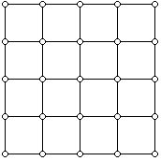
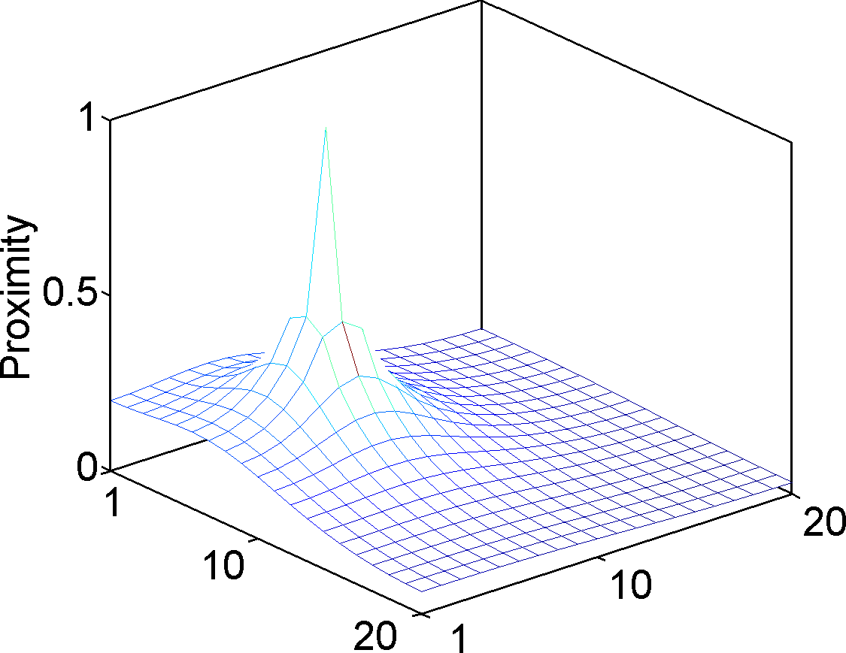
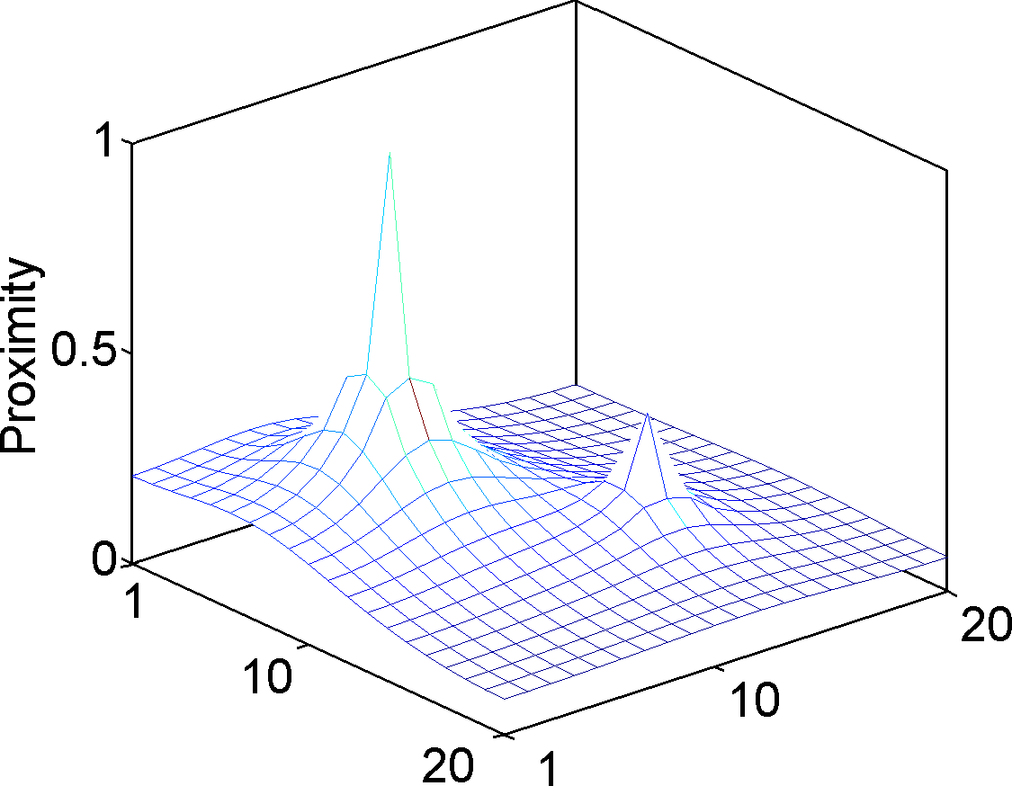
No Local Maximum Property
Grid graph
20
Query
Query
20
Local maximum
No local maximum
With local maximum
Yubao Wu, Ruoming Jin, Xiang Zhang. Fast and unified local search for random walk based $k$-nearest-neighbor query in large graphs. SIGMOD, 2014.
Notes:
How can we achieve these nice properties? Because we observe one key property: the no local maximum property. No local maximum means that for any node, except the query node, we can always find a neighbor node with larger proximity value.
For example, the left figure shows the distribution of the proximity values in a grid graph, where the proximity measure has no local maximum. So, for any node, such as the green node, we can find one neighbor with larger proximity value.
On the other hand, if one proximity measure has local maximum, then we may find one node, which has larger proximity value than any neighbors. Such as the green node in the right figure has larger proximity value than all the neighbors.

Slide 21
Measures With and Without Local Maximum
Abbr. | Proximity measures | Local maximum ?
HT | Hitting time | No
DHT | Discounted hitting time | No
THT | Truncated hitting time | No
PHP | Penalized hitting probability | No
EI | Effective importance (degree normalized RWR) | No
RWR | Random walk with restart | Yes
CT | Commute time | Yes
Yubao Wu, Ruoming Jin, Xiang Zhang. Fast and unified local search for random walk based $k$-nearest-neighbor query in large graphs. SIGMOD, 2014.
Notes:
We examine the existing proximity measures. Some of them have no local maximum, such as hitting time, discounted hitting time, truncated hitting time, penalized hitting probability, and effective importance. Some of them do have local maximum, such as random walk with restart, and commute time.

Slide 22
Bounding the Unvisited Nodes
Grid graph
20
Query
Query
20
Local maximum
Visited
Unvisited
Boundary
Boundary
No local maximum
With local maximum
Yubao Wu, Ruoming Jin, Xiang Zhang. Fast and unified local search for random walk based $k$-nearest-neighbor query in large graphs. SIGMOD, 2014.
Notes:
If one proximity measure has no local maximum, then, the maximum in the boundary of visited nodes can be used as the upper bound of proximity values of unvisited nodes. For example, in the left figure, the green node is an unvisited node, and its proximity value can be upper bounded by the maximum in the boundary of visited nodes.
If one proximity measure has local maximum, then, we do not have this nice property.

Slide 23
Bounding the Visited Nodes
Upper bound
Exact proximity value
Lower bound
Query
Visited node
Unvisited node
Yubao Wu, Ruoming Jin, Xiang Zhang. Fast and unified local search for random walk based $k$-nearest-neighbor query in large graphs. SIGMOD, 2014.
Notes:
Since we only have the local neighborhood information, we cannot compute the exact proximity values. Because the random walk process involves the entire graph. But, we can compute the lower and upper bounds.
In this figure, the red line segment represents the exact proximity value, the blue one represents the upper bound, and the green one represents the lower bound. For the visited nodes, we can compute the lower and upper bounds. For the unvisited nodes, we have the upper bound.
Why do we compute the lower and upper bounds? Because when the bounds are tight enough, we can identify the top-k nodes earlier. Therefore the search space can be pruned.

Slide 24
Bounding the Visited Nodes——Monotonicity
Upper bound
Exact proximity value
Lower bound
Query
Visited node
Unvisited node
Yubao Wu, Ruoming Jin, Xiang Zhang. Fast and unified local search for random walk based $k$-nearest-neighbor query in large graphs. SIGMOD, 2014.
Notes:
We further discover that when we visit one more node, the upper and lower bounds become tighter. The lower bounds are monotonically increasing. The upper bounds are monotonically decreasing. Eventually they converge to the exact proximity values.

Slide 25
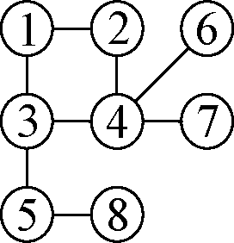
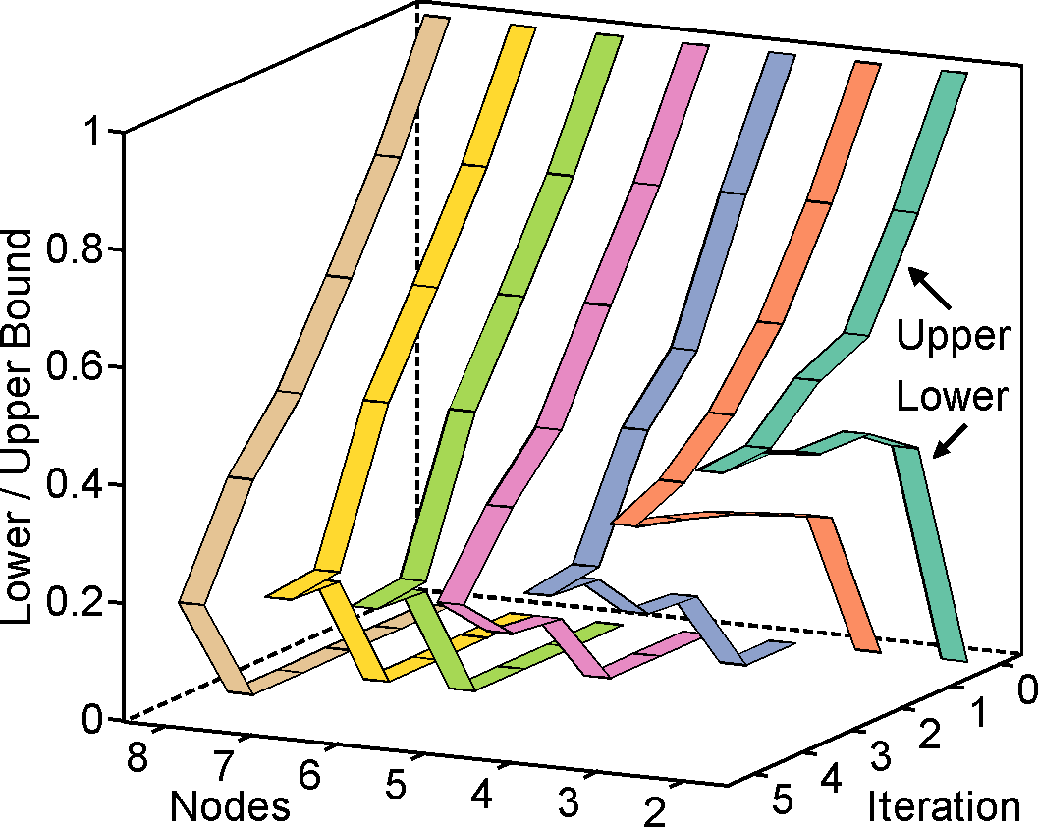
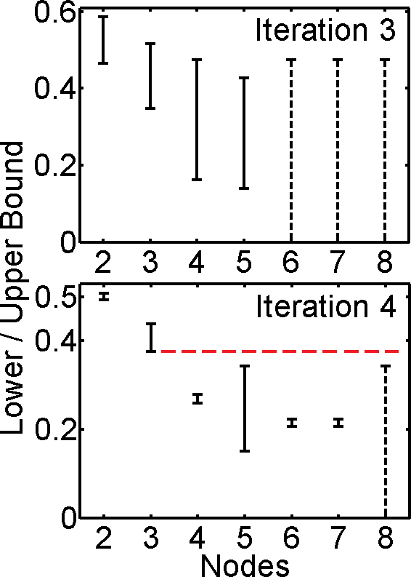
Running Example
Query
Iteration | 1 | 2 | 3 | 4 | 5
Newly visited nodes | {2,3} | {4} | {5} | {6,7} | {8}
Toy graph
Top-2 nodes
Trend of the bounds
Yubao Wu, Ruoming Jin, Xiang Zhang. Fast and unified local search for random walk based $k$-nearest-neighbor query in large graphs. SIGMOD, 2014.
Notes:
Let’s look at a running example. Suppose we have a toy graph, and node 1 is the query node. The algorithm visits the nodes in the order shown in the table. In the first iteration, nodes 2 and 3 are visited; in the second iteration, node 4 is visited, and so on so forth.
At each iteration, we compute the lower and upper bounds of each node, and we plot the bounds in this figure. The x axis represents the nodes, the y axis represents the iteration, and the z axis represents the lower and upper bounds. We can see that the lower and upper bounds are monotonically changing, and eventually converge to the exact proximity values.
Let’s take a closer look at the bounds at the fourth iteration. The interval between the lower and upper bounds are represented by the vertical line segment. We can see that the lower bounds of nodes 2 and 3 are greater than the upper bounds of the remaining nodes. Therefore, we guarantee that nodes 2 and 3 are the top-2 nodes. And the algorithm can terminate.
This running example illustrates the basic idea of the fast local search algorithm.

Slide 26
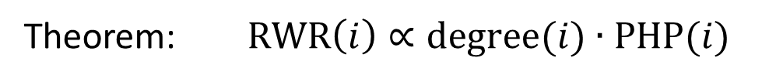
Relationships Among Proximity Measures
Penalized hitting probability
Effective importance
Discounted hitting time
Theorem: PHP, EI, and DHT give the same ranking results.
Random walk with restart
Theorem: $RWR\left(i\right)∝degree(i)∙PHP(i)$
Note: RWR has local maximum
Yubao Wu, Ruoming Jin, Xiang Zhang. Fast and unified local search for random walk based $k$-nearest-neighbor query in large graphs. SIGMOD, 2014.
Notes:
The FLoS algorithm can be applied to a variety of proximity measures.
We first prove that the penalized hitting probability, effective importance, and discounted hitting time give the same ranking results. Therefore, we only need to develop the algorithm for one proximity measure. Then all of them can be solved.
We further discover that the random walk with restart has a simple relationship with penalized hitting probability. Based on this relationship, the FLoS algorithm can also be applied to random walk with restart. This is interesting. Because even though the random walk with restart has local maximum, the fast local search algorithm is still applicable.

Slide 27
Experiments —— Datasets
Datatsets |  | Abbr. | #nodes | #edges
Real | Amazon | AZ | 0,334,863 | 00,925,872
 | DBLP | DP | 0,317,080 | 01,049,866
 | Youtube | YT | 1,134,890 | 02,987,624
 | LiveJournal | LJ | 3,997,962 | 34,681,189
Synthetic | In-memory | -- | Varying size
 |  | -- | Varying density
 | Disk-resident | -- | Varying size
Yubao Wu, Ruoming Jin, Xiang Zhang. Fast and unified local search for random walk based $k$-nearest-neighbor query in large graphs. SIGMOD, 2014.
Notes:
In the experiments, we use 4 real large graphs with up to millions of nodes and tens of millions of edges. We also use in-memory and disk-resident synthetic graphs with different parameters, such as graph size, and graph density.

Slide 28
Experiments —— State-of-the-Art Methods
Our methods (exact) | State-of-the-art methods
 | Abbr. | Key idea | Ref. | Exactness
FLoS_PHP | GI_PHP | Global iteration | -- | Exact
 | DNE | Local search | CIKM’12 | Approx.
 | NN_EI | Local search | CIKM’13 | Exact
 | LS_EI | Local search | KDD’10 | Approx.
FLoS_RWR | GI_RWR | Global iteration | -- | Exact
 | Castanet | Improved GI | SIGMOD’13 | Exact
 | K-dash | Matrix inversion | VLDB’12 | Exact
 | GE_RWR | Graph embedding | VLDB’13 | Approx.
 | LS_RWR | Local search | KDD’10 | Approx.
Yubao Wu, Ruoming Jin, Xiang Zhang. Fast and unified local search for random walk based $k$-nearest-neighbor query in large graphs. SIGMOD, 2014.
Notes:
We test the performance of FLoS algorithm for two proximity measures: penalized hitting probability and random walk with restart. We compare them with several state-of-the-art methods. For penalized hitting probability, we compare it with global iteration method, and 3 local search methods. For random walk with restart, we compare it with global iteration method, improved global iteration method, matrix inversion based method, graph embedding based method, and one local search method. Our methods guarantee the exactness of the results. Some of the existing methods are exact. Some of them are approximate.

Slide 29
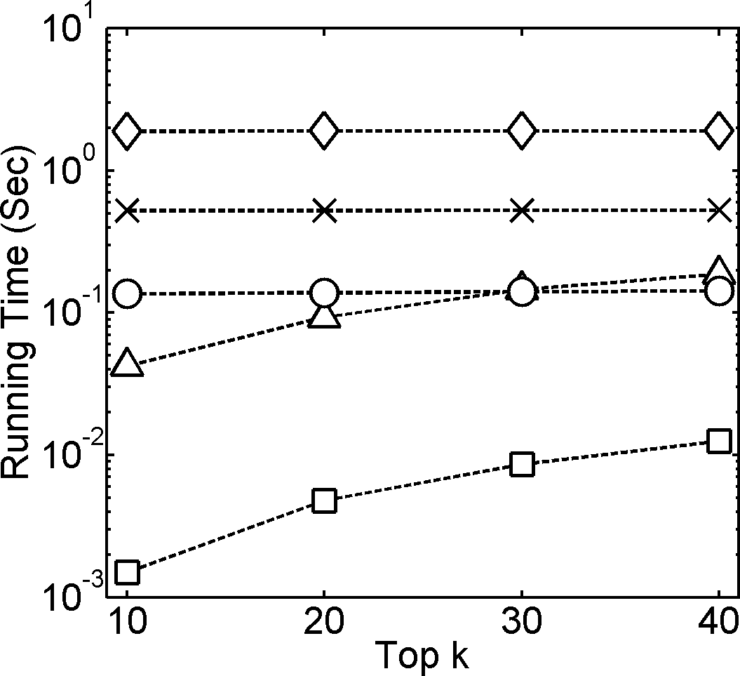
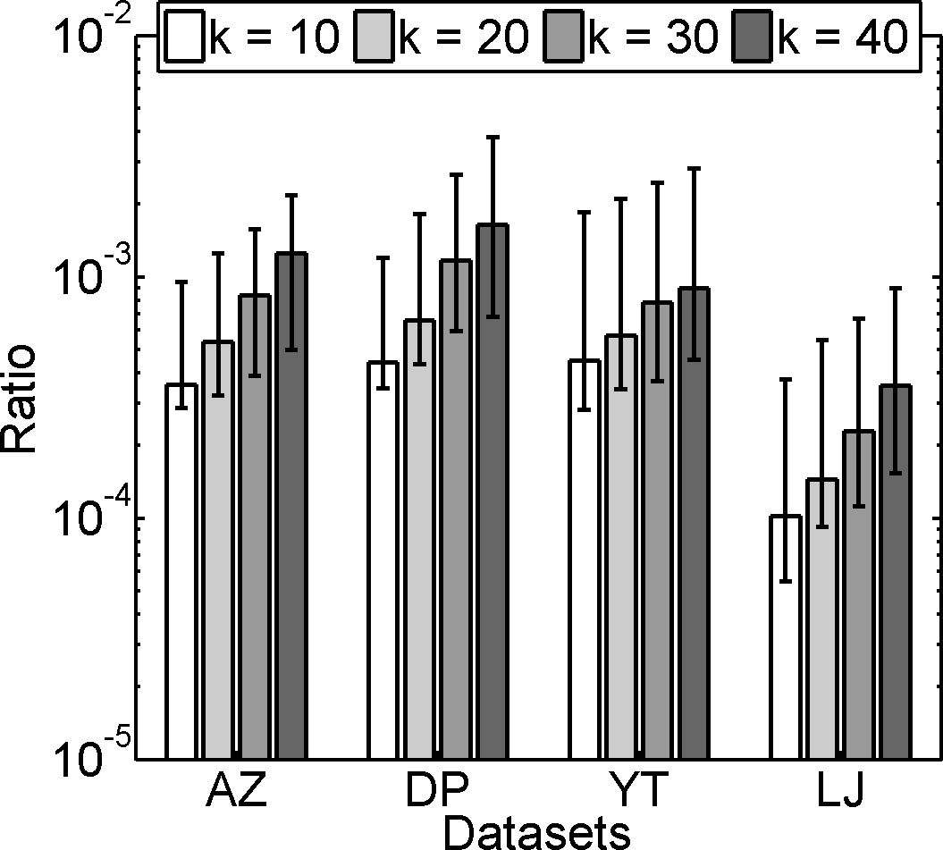
Experiments —— PHP, Real Graphs
Running time (AZ)
# Visited nodes
1-3 orders of magnitude faster
A small portion of the nodes are visited
Yubao Wu, Ruoming Jin, Xiang Zhang. Fast and unified local search for random walk based $k$-nearest-neighbor query in large graphs. SIGMOD, 2014.
Notes:
These are the results for penalized hitting probability on real graphs.
The left figure shows the running time. The x axis represents the varying number K. The y axis represents the running time. The bottom curve shows the running time of our method. We can see that our method is 1 to 3 orders of magnitude faster than the existing methods.
The number of visited nodes is shown in the right figure. The x axis represents the datasets. The y axis represents the ratio between the number of visited nodes using FLoS and the total number of nodes in the graph. Only a small portion of nodes are visited.

Slide 30
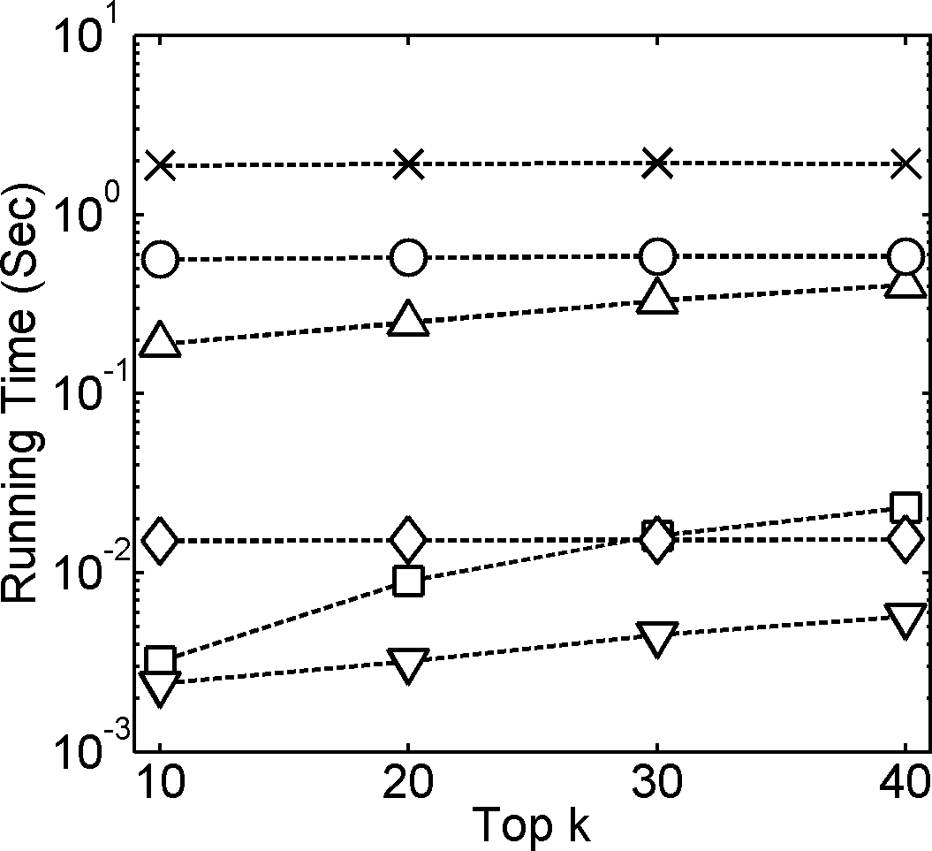
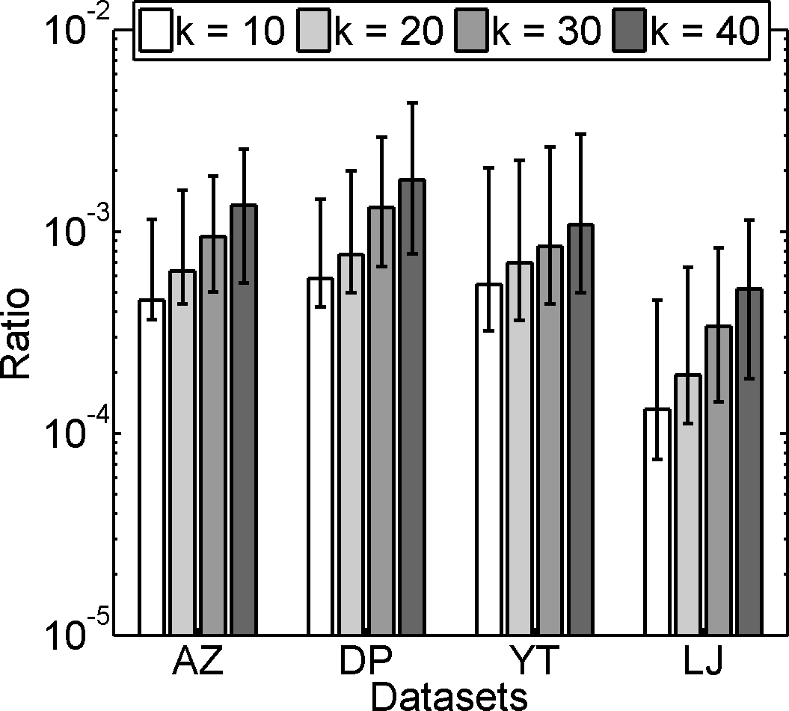
Experiments——RWR, Real Graphs
Have long precomputing time
Running time (AZ)
# Visited nodes
⦁ Fast ⦁ A small portion of the nodes are visited
Yubao Wu, Ruoming Jin, Xiang Zhang. Fast and unified local search for random walk based $k$-nearest-neighbor query in large graphs. SIGMOD, 2014.
Notes:
These are the results for random walk with restart on real graphs.
The left figure shows the running time. The running time of our method is indicated by the curve with square mark in the bottom region. We can see that our method is comparable to two existing methods with pre-computation step. The first one is the graph embedding based method. But the graph embedding based method is approximate, and the graph embedding step is time consuming. The other one is the matrix based method. But pre-computing the matrix inversion is time consuming. Both of these two methods have long pre-computing time, which is not shown here.
The number of visited nodes is shown in the right figure. Only a small portion of nodes are visited.

Slide 31
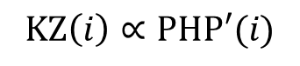
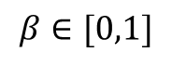
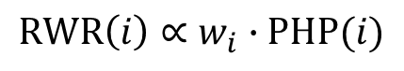
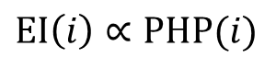
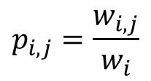
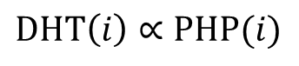
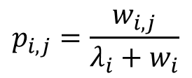
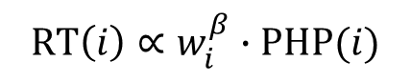
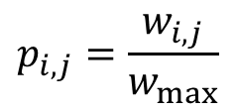
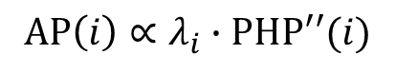
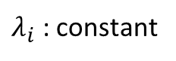
Extension to More Proximity Measures
RWR
$$KZ\left(i\right)∝PHP′(i)$$
PHP’
KZ
$$EI\left(i\right)∝PHP(i)$$
$$RWR\left(i\right)∝w_{i}∙PHP(i)$$
$$p_{i,j}=\frac{w_{i,j}}{w_{max}}$$
EI
PHP
$$p_{i,j}=\frac{w_{i,j}}{w_{i}}$$
DHT
$$p_{i,j}=\frac{w_{i,j}}{λ_{i}+w_{i}}$$
$λ_{i}$ : constant
$$RT\left(i\right)∝w_{i}^{β}∙PHP(i)$$
$$DHT\left(i\right)∝PHP(i)$$
PHP’’
AP
RT
$$β∈[0,1]$$
$$AP\left(i\right)∝λ_{i}∙PHP′′(i)$$
PHP: | Penalized Hitting Probability
RWR: | Random Walk with Restart
EI: | Effective Importance
DHT: | Discounted Hitting Time
RT: | RoundTripRank
KZ: | Katz score
AP: | Absorption Probability
Notes:
Previously, we find the relationship among the proximity measures, and extend the FLoS algorithm to more proximity measures. In the extension of this work, we further the relationships among more proximity measures. They are RoundTripRank, Katz score, and absorption probability. Therefore, the FLoS algorithm can also be applied to these proximity measures.
There is a simple relationship between penalized hitting probability and RoundTripRank, thus we can compute the upper and lower bounds of the exact proximity value of RoundTripRank.
To develop the relationship between penalized hitting probability and Katz score, we first define a variant of PHP proximity measure. In the new measure, the transition probability is normalized by the maximum node degree instead of the node degree. Then we prove that PHP’ and Katz score give the same ranking results.
Similarly, to develop the relationship between PHP and AP, we first define a variant of PHP proximity measure. In the new measure, the transition probability is different from the original one. Here, \lambda_i is a constant value of node i. The transition probability is normalized by the sum of \lambda_i and node degree. Then, we prove that there is a simple relationship between PHP” and AP.

Slide 32
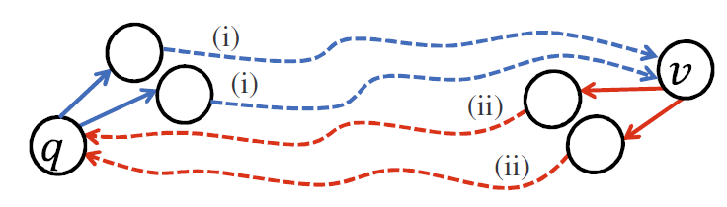
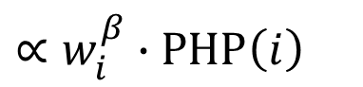
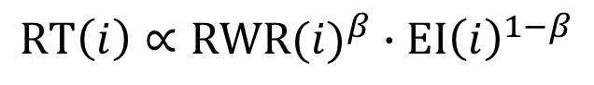






Extension to RoundTripRank
i) How important?
Reaching $v$ from $q$
ii) How specific?
Returning to $q$ from $v$
RoundTripRank :
$$RT\left(i\right)∝{RWR(i)}^{β}∙{EI\left(i\right)}^{1−β}$$
$$RWR\left(i\right)∝w_{i}∙PHP(i)$$
$$β∈[0,1]$$
$$∝w_{i}^{β}∙PHP\left(i\right)$$
$$EI\left(i\right)∝PHP(i)$$
i) Forward direction (RWR)
ii) Backward direction (EI)
$x_{i}=\left\{\begin{matrix}c\sum_{j∈N_{i}}{p_{j,i}x_{j}}+(1−c) & if i=q \\ c\sum_{j∈N_{i}}{p_{j,i}x_{j}} & if i≠q\end{matrix}\right.$
$y_{i}=\left\{\begin{matrix}c\sum_{j∈N_{i}}{p_{i,j}y_{j}}+(1−c) & if i=q \\ c\sum_{j∈N_{i}}{p_{i,j}y_{j}} & if i≠q\end{matrix}\right.$
RWR | Random Walk with Restart
EI | Effective Importance
RT | RoundTripRank
PHP | Penalized Hitting Probability
[1] Yuan Fang, et al. RoundTripRank: Graph-based proximity with importance and specificity? ICDE, 2013.
Notes:
Let us introduce the relationships with more details.
Let’s first consider the relationship between PHP and RoundTripRank.
The RoundTripRank proximity measures consider a round trip from the query node to each node v and then back to the query node.
The forward direction from the query node to node v measures the importance of node v. The backward direction from node v to the query node measures the specificity of node v. The RoundTripRank considers both the importance and specificity of one node.
It is shown that the RoungTripRank proximity value can be decomposed as the product of two proximity measures: random walk with restart and effective importance. The proximity value contributed by the forward direction is actually the random walk with restart proximity value. The proximity value contributed by the backward direction is actually the effectiveness importance proximity value.
Since both random walk with restart and effectiveness importance have simple relationships with penalized hitting probability, we can derive the relationship between RoundTripRank and Penalized hitting probability.

Slide 33











Extension to Katz score
Let $W$ be the adjacency matrix, $R$ be the proximity matrix,
$R_{i,j}$ be the KZ proximity value between node $i$ and $j$
$$R=κW+κ^{2}W^{2}+κ^{3}W^{3}+⋯$$
${[W^{2}]}_{i,j}$ : # of paths of length 2
$κ (0<κ<1)$ : decay factor
Recursive equations for KZ
Recursive equations for PHP’
$r_{i}=\left\{\begin{matrix}c\sum_{j∈N_{i}}{p_{i,j}r_{j}}+\frac{1}{w_{max}} & if i=q \\ c\sum_{j∈N_{i}}{p_{i,j}r_{j}} & if i≠q\end{matrix}\right.$
$r_{i}=\left\{\begin{matrix}1 & if i=q \\ c\sum_{j∈N_{i}}{p_{i,j}r_{j}} & if i≠q\end{matrix}\right.$
$$p_{i,j}=\frac{w_{i,j}}{w_{max}}$$
where, $c=κ∙w_{max}$
$$KZ\left(i\right)∝PHP′(i)$$
where,
$$p_{i,j}=\frac{w_{i,j}}{w_{max}}$$
$$p_{i,j}=\frac{w_{i,j}}{w_{i}}$$
PHP’:
KZ | Katz score
PHP | Penalized Hitting Probability
PHP’ | variant of PHP
[1] Leo Katz. A new status index derived from sociometric analysis. Psychometrika 18.1 (1953): 39-43.
Notes:
Katz score is a classic proximity measure in graph. It is not based on random walk, but this result shows that it has close relationship with the random walk based proximity measures.
Katz score is defined as a weighted sum of the lengths of paths between two nodes.
Let matrix R denote the proximity matrix, and matrix W denote the adjacency matrix. Katz score proximity matrix can be defined in this series form. The i-th term in this series denotes the number of paths of length i.
We can take one column of the proximity matrix R as a proximity vector, and derive a recursive equation for the proximity vector. We define a new proximity measure. This is similar to PHP. The difference is that the transition probability is normalized by the maximum degree. This is the same as that in the recursive equation of Katz score.

Slide 34





Extension to Absorption Probability
self-loop trans. prob.
PHP
AP
, PHP’’
$p_{i,j}=\left\{\begin{matrix}\frac{λ_{i}}{λ_{i}+w_{i}} & if i=j \\ \frac{w_{i,j}}{λ_{i}+w_{i}} & if i≠j\end{matrix}\right.$
$p_{i,j}=\left\{\begin{matrix}0 & if i=j \\ \frac{w_{i,j}}{w_{i}} & if i≠j\end{matrix}\right.$
original graph
4
5
4
5
4
5
8
8
8
3
3
7
3
7
2
6
2
6
2
6
1
1
7
1
recursive equation for AP
$$AP\left(i\right)∝λ_{i}∙PHP′′(i)$$
recursive eq. for PHP’’
$r_{i}^{′}=\left\{\begin{matrix}\sum_{j∈N_{i}}{p_{i,j}r_{j}^{′}}+\frac{1}{λ_{i}+w_{i}} & if i=q \\ \sum_{j∈N_{i}}{p_{i,j}r_{j}^{′}} & if i≠q\end{matrix}\right.$
$r_{i}=\left\{\begin{matrix}1 & if i=q \\ \sum_{j∈N_{i}}{p_{i,j}r_{j}} & if i≠q\end{matrix}\right.$
AP | Absorption probability
PHP | Penalized Hitting Probability
PHP” | Variant of PHP
[1] Xiao-Ming Wu, et al. Learning with partially absorbing random walks. NIPS, 2012.
Notes:
In the absorption probability proximity measure, each node has a self-loop transition probability. Starting from the query node, the random surfer randomly walks to the neighbors. With this probability, the random surfer will be absorbed at this node forever.
The original AP proximity measure is formulated in this recursive equation. It involves the entire proximity matrix. We derive a new recursive equation for it. This recursive equation only involves one column of the proximity matrix.
We replace the proximity value of the query node with a constant value 1. And we define a variant of PHP proximity measure, the PHP”. The PHP’’ proximity measure is very similar to the PHP proximity measure. Thus, the FLoS algorithm is still applicable to PHP”. By use of the simple relationship between AP and PHP”, the FLoS algorithm is applicable to AP.

Slide 35











Reverse-Proximity Query Problem
proximity matrix $R$
$$q$$
$$i$$
Proximity value of node $i$
$R_{q,i}$ : proximity value of node $i$ w.r.t. $q$
$$q$$
Reverse-proximity value of node $i$
$$i$$
$R_{i,q}$ : proximity value of node $q$ w.r.t. $i$
Naïve solution:
Query each node : $O(αm)$
Total running time : $O(αmn)$
Andras A. Benczur, et al. SpamRank - Fully Automatic Link Spam Detection Work in progress. In AIRWeb, 2005.
Yuan Fang, et al. RoundTripRank: Graph-based proximity with importance and specificity. In ICDE, 2013.
Notes:
Given a query node q, we can compute the proximity values of all other nodes. We can also use each node i as the query, and compute the proximity value of q. We refer to this proximity of node q as the reverse-proximity of node i.
Suppose we have this proximity matrix R. Given the query node q, the proximity values of other nodes exist in one row of the proximity matrix. And it is the proximity vector. By using each node i as the query node, the proximity values of node q exist in one column of the proximity matrix. We refer to this column of the proximity matrix as the reverse-proximity vector.
The top-k reverse-proximity query problem aims at finding the top-k nodes based on the reverse-proximity values. This reverse-proximity values are used in link spam detection.
Naively, we can use each node as the query to compute the proximity value of the query node. But the computational complexity is prohibitive.

Slide 36








Extension to Reverse-Proximity Measures
$$rEI\left(i\right)∝PHP(i)$$
$$rKZ\left(i\right)∝PHP′(i)$$
rRWR
rEI
PHP’
rKZ
$$rRWR\left(i\right)∝PHP(i)$$
$$rPHP\left(i\right)∝\frac{PHP(i)}{{EI}_{i}(i)}$$
$$p_{i,j}=\frac{w_{i,j}}{w_{max}}$$
rPHP
PHP
$$p_{i,j}=\frac{w_{i,j}}{w_{i}}$$
$$rDHT\left(i\right)∝\frac{PHP(i)}{{EI}_{i}(i)}$$
$$p_{i,j}=\frac{w_{i,j}}{λ_{i}+w_{i}}$$
$λ_{i}$ : constant
$$rRT\left(i\right)∝w_{i}^{1−β}∙PHP(i)$$
rDHT
PHP’’
rAP
rRT
$$β∈[0,1]$$
${EI}_{i}(i)$ is pre-computed.
$$rAP\left(i\right)∝PHP′′(i)$$
PHP: | Penalized Hitting Probability
RWR: | Random Walk with Restart
EI: | Effective Importance
DHT: | Discounted Hitting Time
RT: | RoundTripRank
KZ: | Katz score
AP: | Absorption Probability
Notes:
In this work, we show that the FLoS algorithm can be used to compute the top-k reverse-proximity query for these proximity measures.
We show that there are simple relationships between each reverse-proximity measure and the PHP proximity measure. By using this simple relationship, we can develop the lower and upper bounds. Thus the FLoS algorithms can be applied to these reverse-proximity measures.
For example, the reverse random walk with restart and PHP give the same ranking results. For reverse-Katz score and reverse-absorption probability, we first define PHP’ and PHP” measures, which are variants of the PHP proximity measure. And then, we discover the relationships between PHP’ and Katz score, and PHP” and absorption probability.

Slide 37




Experimental Results —— Running Time
RT
KZ
AP
rPHP
Yubao Wu, Ruoming Jin, Xiang Zhang. Unified and Exact Local Search for Random Walk Based Top-K Proximity Query in Large Graphs. Submitted to VLDBJ, 2015.
Notes:
We apply the FLoS algorithms on large real networks. These figures show the running time of the FLoS algorithms for RoundTripRank, Katz score, absorption probability, and reverse-penalized hitting probability. For other reverse proximity measures, they give the same ranking results as PHP or its variants, thus there is no need to evaluate the FLoS algorithm for them.
The bars on the left show the running time of the FLoS method. The Y-axis represents the running time. The X-axis represents the datasets. Each gray level of the bar represents of the number k in the top-k query. They are top-10, 20, 30, and 40 in the experiments.
From the results, we can see that the running time of our method is 2-3 orders of magnitude smaller than the running time of the global iteration method, and is 1-2 orders of magnitude smaller than the running time of other state-of-the-art methods.

Slide 38



Experimental Results —— # of Visited Nodes
YT
LJ
All are local search methods
Notes:
We further compare the number of visited nodes in the local search algorithms.
The Y-axis represents the ratio between the number of visited nodes and the total number of nodes. The X-axis represents different proximity measures. Each gray level represents the number K in the top-K query. We can see that the number of visited nodes is much smaller than those of the existing local search algorithms. This is because of the tight bounds.

Slide 39
Contributions
Tasks | Limitations of existing works | Our contributions
Local community detection | Free rider effect | Query biased densest subgraph
Top-$k$ proximity query | Global : expensive; Local : approximate; specific | Simple, unified and exact local search
Densest subgraph detection | Single network; Co-dense; | Dual networks; Densest connected subgraph
Yubao Wu, Ruoming Jin, Jing Li, and Xiang Zhang. Robust local community detection: on free rider effect and its elimination. PVLDB, 2015.
Yubao Wu, Ruoming Jin, Xiang Zhang. Fast and unified local search for random walk based $k$-nearest-neighbor query in large graphs. SIGMOD, 2014.
Yubao Wu, Ruoming Jin, Xiaofeng Zhu, and Xiang Zhang. Finding dense and connected subgraphs in dual networks. ICDE, 2015.
Notes:
In conclusion, we propose a simple, unified and exact local search algorithm. Next, I will introduce the densest connected subgraph problem in dual networks.

Slide 40




Dual Biological Networks
(a) protein interaction network
(b) genetic interaction network
Edge: physical bounding interaction
Edge: conceptual statistical interaction
( $χ^{2}$ test score )
Yubao Wu, Ruoming Jin, Xiaofeng Zhu, and Xiang Zhang. Finding dense and connected subgraphs in dual networks. ICDE, 2015.
Notes:
We can observe dual networks in real life. For example, we have protein interaction network. And we also have the genetic interaction network which is constructed from the genome-wide association study dataset. The edge in the protein interaction network represents the physical bounding interaction. While the edge in the genetic interaction network represents the statistical interaction. These edges are over the same set of nodes. So we call this dual networks. The key question is how to use the protein interaction to interpret the genetic interaction.

Slide 41


Other Dual Networks
 | Dual social networks | Dual Co-author networks
Physical network | Social network | Co-author network
Conceptual network | Interest similarity network | Research interest similarity network
Yubao Wu, Ruoming Jin, Xiaofeng Zhu, and Xiang Zhang. Finding dense and connected subgraphs in dual networks. ICDE, 2015.
Notes:
We observe dual social networks in the Flixster website. There is a social network among the users. And the users can also rate the movies. Based on the ratings, we can construct the interest similarity network among the users.
We also observe the dual co-author networks. There is a collaboration network. We can also construct the research interests similarity network based on the keywords in the paper title.

Slide 42




Densest Connected Subgraph
$$G_{a}(V, E_{a})$$
: $\frac{\left|E(S)\right|}{\left|S\right|}$
$$G_{b}(V, E_{b})$$
The Densest Connected Subgraph (DCS) Problem:
Given dual networks $G(V, E_{a},E_{b})$, find $S⊆V$ such that:
(a) $G_{a}[S]$ is connected;
(b) the density of $G_{b}[S]$ is maximized.
Yubao Wu, Ruoming Jin, Xiaofeng Zhu, and Xiang Zhang. Finding dense and connected subgraphs in dual networks. ICDE, 2015.
Notes:
There exist so many dual networks. So, we propose the dual networks model, which contains two networks: physical network, and conceptual network. Then we study the densest connected subgraph problem, which is also called the DCS problem. In the DCS problem, we want to find a subgraph, which is connected in the physical network, and dense in the conceptual network.

Slide 43
DCS in Dual Networks
Dual networks | Dual biological | Dual social | Dual co-author
DCS | Disease pathway | Consumer group (advertising) | Research group
Connectivity | Signal transduction | word-of-mouth | Collaboration pattern
Density | Statistical association | Consumer interest | Similar research interest
Theorem: The DCS problem is NP-hard.
Yubao Wu, Ruoming Jin, Xiaofeng Zhu, and Xiang Zhang. Finding dense and connected subgraphs in dual networks. ICDE, 2015.
Notes:
Why DCS pattern? Because it is meaningful. For example, in dual biological networks, the DCS can be interpreted as the disease pathway. The connectivity in protein interaction network represents the signal transduction process; the density in genetic interaction network represents the strong statistical association.
DCS also has practical meanings in other types of dual networks.
We formally prove that DCS problem is NP-hard. And we propose two approximation algorithms.

Slide 44
DCS_RDS Algorithm
Step 1. Find the densest subgraph in the conceptual network
Step 2. Make it connected in the physical network
DCS_GND Algorithm
At each iteration, it deletes a set of nodes
1) low degree in the conceptual network
2) Connectivity of the physical network
Yubao Wu, Ruoming Jin, Xiaofeng Zhu, and Xiang Zhang. Finding dense and connected subgraphs in dual networks. ICDE, 2015.
Notes:
The first algorithm is called refining densest subgraph algorithm. There are two steps. First, we find the densest subgraph in conceptual network. And then we put the densest subgraph into the physical network to make it connected.

Slide 45

Experiments
Three kinds of the dual networks
Dual networks | Physical network | Conceptual network | Data sources
Biological | protein interaction | genetic interaction | BioGrid; WTCCC
Co-author | co-author network | research interest similar. | DBLP
Social | social network | interest similarity | Flixster / Epinions
Statistics of the dual networks
Dual networks | Abbr. | #nodes | #edges in $G_{a}$ | #edges in $G_{b}$
Protein-Genetic | Bio | 8,468 | 25,715 | 67,744
Research-DM | DM | 7,169 | 14,526 | 30,000
Research-DB | DB | 6,131 | 17,940 | 30,000
Recom-Epinions | EP | 49,288 | 487,002 | 313,432
Recom-Flixster | FX | 786,936 | 7,058,819 | 2,713,671
Yubao Wu, Ruoming Jin, Xiaofeng Zhu, and Xiang Zhang. Finding dense and connected subgraphs in dual networks. ICDE, 2015.
Notes:
In the experiments, we use three types of dual networks to evaluate the effectiveness and efficiency.
They are dual biological networks, dual co-author networks, and dual social networks.

Slide 46


DCS_$k$ from dual biological networks ($k=40$, WTCCC)
(a) Subgraph in protein interaction network
(b) Subgraph in genetic interaction network
MYO6, CUBN, and STK39 have been reported to be associated with hypertension disease.
Yubao Wu, Ruoming Jin, Xiaofeng Zhu, and Xiang Zhang. Finding dense and connected subgraphs in dual networks. ICDE, 2015.
Notes:
This is the DCS pattern discovered from dual biological networks. From the figure, we can see that the subgraph is sparsely connected in the protein interaction network, and densely connected in the genetic interaction network. We also find some interesting genes that have been reported to be associated with the disease.

Slide 47


DCS_seed from dual biological networks (WTCCC)
(a) Subgraph in protein interaction network
(b) Subgraph in genetic interaction network
Renin pathway genes are in red ellipses.
NEDD4L has been reported to be associated with hypertension disease.
Yubao Wu, Ruoming Jin, Xiaofeng Zhu, and Xiang Zhang. Finding dense and connected subgraphs in dual networks. ICDE, 2015.
Notes:
We take the genes in the renin pathway as the seed nodes. Because renin pathway is known to be associated with hypertension disease.
We find the DCS pattern near the seed nodes, which is shown in the Figures. The genes in the red ellipses are the seed genes.
We can see that the seed genes originally are disconnected in the protein interaction network. After we add some new genes, they become connected in the protein interaction network. And they are densely connected in the genetic interaction network.

Slide 48

Significance evaluation
Methods | GenGen | GRASS | Plink | HYST
DCS | $$2.4×{10}^{−6}$$ | $$1.0×{10}^{−6}$$ | $$2.3×{10}^{−6}$$ | $$1.1×{10}^{−6}$$
DCS_$k$ | $$5.6×{10}^{−6}$$ | $$1.3×{10}^{−6}$$ | $$4.6×{10}^{−6}$$ | $$3.7×{10}^{−6}$$
DCS_seed | $$8.5×{10}^{−6}$$ | $$4.9×{10}^{−6}$$ | $$1.5×{10}^{−6}$$ | $$2.5×{10}^{−6}$$
DS | 0.36 | 0.47 | 0.33 | 0.17
MSCS | 0.15 | 0.13 | 0.21 | 0.12
DCSs are identified from the WTCCC dataset; testing on the ARIC dataset.
DS: densest subgraph in protein interaction network;
MSCS: maximum score connected subgraph
Yubao Wu, Ruoming Jin, Xiaofeng Zhu, and Xiang Zhang. Finding dense and connected subgraphs in dual networks. ICDE, 2015.
Notes:
We further use four state-of-the-art pathway evaluation methods to evaluate the significance of the detected pathways. The results are shown in the table. We can see that the detected subgraphs are significant. The baseline methods fail to detect the significant pathways.

Slide 49




DCS_𝑘 ($k=30$, data mining research community)
Dual Co-Author Networks
(a) Subgraph in co-author network
(b) Subgraph in research interest similarity net.
DCS_seed (database research community)
Yubao Wu, Ruoming Jin, Xiaofeng Zhu, and Xiang Zhang. Finding dense and connected subgraphs in dual networks. ICDE, 2015.
Notes:
This is the DCS pattern from dual co-author networks. The subgraph in the co-author network shows the collaboration pattern among the researchers. The subgraph in research interest similarity network represents that they have similar research interests.

Slide 50


Dual Biological Networks —— Node Weights
(a) protein interaction network
(b) genetic interaction network
Edge: physical bounding interaction
Edge: conceptual statistical interaction
Edge Weights :
two-locus test statistics
Node Weights :
single-locus test statistics
Genetic Marker 1 |  | Genetic Marker 2 |  | $$χ^{2}$$ test score
Gene | Maker ID | Gene | Marker ID
SLC12A3 | rs11076172 | ABCG5 | rs10495909 | 3.29
SLC12A3 | rs11076172 | THBS2 | rs9294977 | 2.89
SLC12A3 | rs11076172 | HDAC2 | rs13194921 | 2.43
Genetic Markers |  | $$χ^{2}$$ test score
Gene | Maker ID
ESR1 | rs11155820 | 1.18
SLC12A3 | rs11076172 | 1.01
ABCG5 | rs10495909 | 0.96
Notes:
In the extension work, we extend the dual networks to contain node weights. We observe node weights in real dataset. In the biological network, the edge weights represent the two-locus test statistics, and the node weights represent the single-locus test statistics. Both the single- and two-locus test statistics denote the correlation of the protein and the disease phenotype. And both the single- and two-locus test statistics should be considered when we try to mine the disease genes.

Slide 51









Extension —— Node Weights
: $\frac{e(S)}{\left|S\right|}$
(edge weighted)
$$G_{a}(V, E_{a})$$
$$G_{b}(V, E_{b})$$
$w_{i,j}$ : edge weight of edge $(i,j)$
$r(i)$: node weight of node $i$
$e\left(S\right)=\sum_{i,j∈S}{w_{i,j}}$
: $\frac{e\left(S\right)+r(S)}{\left|S\right|}$
(node/edge weighted)
$r\left(S\right)=\sum_{i∈S}{r(i) }$
Yubao Wu, Xiaofeng Zhu, Li Li, Wei Fan, Ruoming Jin, Xiang Zhang. Mining Dual Networks: Models, Algorithms and Applications. TKDD, 2015.
Notes:
In the existing dual network model, in the conceptual network, there are only edge weights, but there are no node weights.
Thus, we extend the dual network model to have both node and edge weights in the conceptual network.
Previously, in the edge weighted conceptual network, the density is defined as the summation of edge weights divided by the number of nodes.
In the new node and edge weighted conceptual network, we define a new density goodness metric. It equals the summation of node and edge weights divided by the number of nodes.

Slide 52


Densest Connected Subgraph : Node Weights
$$G_{a}(V, E_{a})$$
: $\frac{e\left(S\right)+r(S)}{\left|S\right|}$
$$G_{b}(V, E_{b})$$
(node/edge weighted)
The Densest Connected Subgraph (DCS) Problem:
Given dual networks $G(V, E_{a},E_{b})$, find $S⊆V$ such that:
(a) $G_{a}[S]$ is connected;
(b) the density $\frac{e\left(S\right)+r(S)}{\left|S\right|}$ of $G_{b}[S]$ is maximized.
Yubao Wu, Xiaofeng Zhu, Li Li, Wei Fan, Ruoming Jin, Xiang Zhang. Mining Dual Networks: Models, Algorithms and Applications. TKDD, 2015.
Notes:
Based on the new dual networks model and the new density goodness metric, we study the densest connected subgraph problem. It aims at finding a subgraph, such that the subgraph in the physical network is connected, and the subgraph in the conceptual network has the maximum density value. Here, the density is the node and edge weighted density.

Slide 53








DCS_RDS Algorithm
$$G_{b}$$
$$G_{a}$$
$$G_{a}$$
Find the densest subgraph
in conceptual network
(with node weights)
Refine the densest subgraph
in physical network
$$G_{b}$$
Yubao Wu, Xiaofeng Zhu, Li Li, Wei Fan, Ruoming Jin, Xiang Zhang. Mining Dual Networks: Models, Algorithms and Applications. TKDD, 2015.
Notes:
We further extend the two algorithms for the new model and new problem.
For the DCS_RDS algorithm, we still first find the densest subgraph in the conceptual network, and then refine it in the physical network to make it connected.
Finding the densest subgraph in the node and edge weighted network is not well studied. The previous works about densest subgraph detection all focus on the edge weighted network.

Slide 54




Extension of Three Algorithms
$e\left(S\right)=\sum_{i,j∈S}{w_{i,j}}$
$r\left(S\right)=\sum_{i∈S}{r(i) }$
$$\frac{e(S)}{\left|S\right|}$$
$$\frac{e\left(S\right)+r(S)}{\left|S\right|}$$
Density
 | Without node weights | With node weights
greedy node deletion | 2-approximation | 2-approximation
removing low degree nodes | d-core retains the densest subgraph | d-core retains the densest subgraph
parametric maximum flow | exact densest subgraph | exact densest subgraph
Yubao Wu, Xiaofeng Zhu, Li Li, Wei Fan, Ruoming Jin, Xiang Zhang. Mining Dual Networks: Models, Algorithms and Applications. TKDD, 2015.
Notes:
We carefully study the densest subgraph problem with node weights. And we find that all the existing algorithms for the classic density can be easily extended to the density goodness metric with node weights.
For example, the greedy node deletion algorithm can return a 2-approximation subgraph. For the density with node weights, the algorithms still can return a 2-approximation solution. We only change the node degree slightly by introducing node weights.
For the removing low degree algorithm, we also prove that the densest subgraph is still retained in the resulting d-core.
The parametric maximum flow algorithm can still find the exact densest subgraph in polynomial time when we carefully design the capacity in the flow network.

Slide 55














DCS_GND Algorithm
Delete the low degree non-articulation nodes
Articulation nodes
$$G_{a}$$
$$G_{a}$$
$$G_{a}^{′}$$
$$G_{b}$$
$$G_{b}$$
$$G_{b}^{′}$$
Low degree nodes
Compute the density
 | Without Node Weights | With Node Weights
Node degree | $$w(u)$$ | $$w^{′}\left(u\right)=w\left(u\right)+r(u)$$
$w(u)$: node degree
$r(u)$: node weight
Yubao Wu, Xiaofeng Zhu, Li Li, Wei Fan, Ruoming Jin, Xiang Zhang. Mining Dual Networks: Models, Algorithms and Applications. TKDD, 2015.
Notes:
We also extend the DCS_GND algorithm to the node weighted problem. At each iteration, the algorithm still deletes a set of nodes that have low degree in the conceptual network, and at the same time, the algorithm keeps the remaining subgraph connected in the physical network.
Here, because we have node weights, the node degree is changed to the summation of node degree and node weight. If one node has both low node degree and node weight, it will be deleted.

Slide 56



DCS_$k$ from dual biological networks ($k=40$, WTCCC, node weights)
(a) Subgraph in protein interaction network
(b) Subgraph in genetic interaction network
MYO6, CUBN, and STK39 have been reported to be associated with hypertension disease.
Yubao Wu, Xiaofeng Zhu, Li Li, Wei Fan, Ruoming Jin, Xiang Zhang. Mining Dual Networks: Models, Algorithms and Applications. TKDD, 2015.
Notes:
We still use the Wellcome trust dataset to compute the genetic interaction network. But at this time, we also compute the node weights. We apply the proposed algorithm, and detect the DCS pattern. These figures show the results. The node color represents the node weight. The redder the color, the larger the node weight.

Slide 57

Significance evaluation
 | Methods | GenGen | GRASS | Plink | HYST
Without node weights | DCS | $$7.2×{10}^{−6}$$ | $$8.2×{10}^{−6}$$ | $$7.6×{10}^{−6}$$ | $$4.8×{10}^{−8}$$
 | DCS_k | $$8.9×{10}^{−5}$$ | $$1.6×{10}^{−5}$$ | $$2.2×{10}^{−5}$$ | $$4.5×{10}^{−7}$$
 | DCS_seed | $$6.3×{10}^{−4}$$ | $$2.1×{10}^{−5}$$ | $$9.3×{10}^{−5}$$ | $$1.8×{10}^{−5}$$
With node weights | DCS | $$5.8×{10}^{−6}$$ | $$4.6×{10}^{−6}$$ | $$6.7×{10}^{−6}$$ | $$1.4×{10}^{−6}$$
 | DCS_k | $$8.2×{10}^{−5}$$ | $$8.7×{10}^{−6}$$ | $$9.4×{10}^{−6}$$ | $$1.5×{10}^{−7}$$
 | DCS_seed | $$4.1×{10}^{−4}$$ | $$7.7×{10}^{−6}$$ | $$7.4×{10}^{−5}$$ | $$9.1×{10}^{−6}$$
DCSs are identified from the WTCCC dataset; tested on the ARIC dataset.
Yubao Wu, Xiaofeng Zhu, Li Li, Wei Fan, Ruoming Jin, Xiang Zhang. Mining Dual Networks: Models, Algorithms and Applications. TKDD, 2015.
Notes:
We further use four state-of-the-art pathway evaluation methods to evaluate the significance of the detected pathways. The results are shown in the table. We can see that the detected subgraphs using the method with node weights are more significant than those using the method without node weights. This demonstrates that the node weights are necessary to be considered in the proposed model.

Slide 58


Robust Local Community Detection
Top-$k$ Query;
Fast Local Search
Thank You!
Dual Networks;
Densest Connected Subgraph
Yubao Wu, Ruoming Jin, Jing Li, and Xiang Zhang. Robust local community detection: on free rider effect and its elimination. PVLDB, 2015.
Yubao Wu, Ruoming Jin, Xiang Zhang. Fast and unified local search for random walk based $k$-nearest-neighbor query in large graphs. SIGMOD, 2014.
Yubao Wu, Ruoming Jin, Xiaofeng Zhu, and Xiang Zhang. Finding dense and connected subgraphs in dual networks. ICDE, 2015.
Notes:
In conclusion, we first develop an effective local community detection method. Then, we develop one efficient local search algorithm for top-k query problem. Finally, we study the densest connected subgraph in the novel dual networks model.
Thank you! Any questions?

